Slide 1
Titled: Do Social Protection Programs reduce food insecurity? A case study from Malawi
Faculty of Agriculture
Colloquim: Msc Sustainable International Agriculture
Presented by: Akuine Obumneme Chineme
Supervised by: Dr. Legesse Bethelhem Debela
Mr Astewale Melaku

Slide 2
Introduction
Faculty of Agriculture
Food security is said to be achieved when all people at all times have access to sufficient, safe and nutritious food to support a healthy and active life (Food and Agriculture Organization, 2008:1).
8.9% of people worldwide are still food insecure although there has been progress in eliminating hunger globally (World bank, 2020).
Food insecurity is mostly associated with developing nations with;
- Africa having 33.7% of its populations having severe food insecurity,
- Latin America and the caribbean having 14.2% of their population having severe food insecurity,
- While South Asia have an estimated 10.2% severe food insecurity (FAO, 2020).

Slide 3
Introduction
Faculty of Agriculture
Food insecurity is typically measured using surveys that asks people about there access to sufficient and nutritiuos food.
The most commonly used method is the Household Food Insecurity Access scale (HFIAS), developed by FAO.
Other measures of food insecurity include Food Insecurity Scale (FIES), developed by the FAO and World Food Programme,
And the US Household Food Security Survey Module, which is used to access food security in the US.
Other indicators of food insecurity include hunger and malnutrition rates, as well as measures of poverty and income inequality.

Slide 4
Introduction
Faculty of Agriculture
Measures taken to reduce food insecurity includes:
1. Increase food production and distribution (improving food distibution channel and reduction of waste.
2. Increase access to food (e.g implementing food assistance programs such as food banks, improving transportation infrastructure.
3. Improve income and employment opportunities (providing job training, increasing minimum wages
4. Address climate change
5. Improve nutrition education (Helps reduce malnutrition)

Slide 5
Introduction
Faculty of Agriculture
6. Address conflict and displacement.
7. Enhance Social safety nets (Cash transfers, Public work program, microfinance e.t.c)
Social protection simply refers to as a set of state-implemented measures or non-state measures (NGO’s) that;
1. Support individuals and families facing vulnerabilities throughout their lifecycle.
2. Aid people in becoming resilient to shocks and crises.
3. Favor social inclusion and support families in poverty in building human and social capital through income.
4. Support children, elderly, disabled and mostly families with low-income.
(Cirillo & Tebaldi, 2016).

Slide 6
Introduction
Faculty of Agriculture
History of Social Protection
The history of social protection dates back to 19th century, when governments began to implement social welfare programs to address poverty and inequality.
Approximately 2.5 billion people get some form of social assistance worldwide today (Worldbank, 2018)
Types of social protection programs includes;
1. Cash tranfer programs (e.g Brazil, Malawi and Mexico)
2. Social insurance programs (e.g social security in the US, NHIS in Ghana, NHIS in Nigeria).
3. Food assistance programs (e.g. Suplemental Nutrition Assistance Program In US, Public Distribution system (PDS) in India).
4. Public work programs (e.g MASAF in Malawi, NREGS in India and SIF in Jamaica)
5. Conditional cash transfer programs (Colombia, Mexico and Malawi)

Slide 7
Introduction
Faculty of Agriculture
Research Aim
The study intends to shed more light on the impact social protection measures has in alleviating food insecurity in the Malawi.
Research Gap
Very few studies have been carried out on social protection programs in Malawi.
Research Objectives;
Identifying the socio-economic characteristics of the people living in the study area.
Identifying the relationship between social protection and food security &
Identifying other factors that influence food security in the study area.

Slide 8
Materials and Methodology
Faculty of Agriculture
Study Area description
Malawi is Located in the Southeastern part of Africa, bordered by Mozambique, Zambia and Tanzania.
Malawi is a landlocked country which 80% of its workforce are engaged in Agriculture.
Malawi remains one of the poorest countries in the world and its divided into North, Central and Southern region.
(World Bank, 2022)
Data
This paper uses data from World Bank‘s fifth household-integrated survey in Malawi collected in 2019-2020.
Data was cleaned and analysis was ran on 11,427 homes.

Slide 9
Materials and Methodology
Faculty of Agriculture
Model and Method
Because of the kind of data available to us, we adopted the World Food Program (WFP), which uses the food consumption score (FCS) approach for our research.
This metric is a composite score that considers the variety of foods consumed, the frequency with which certain foods are consumed, and the relative nutritional significance of specific food groups in the diets of individual households.
The Food consumption score uses a 7-day recall period.
Associated weights of specific types of foods like cassava, nuts, potatoes etc are added up and matched up against a specific threshold set by the WFP to determine families that are food secured or not.
A dummy variable standing as proxy was employed to differenciate the food secured and the food-insecure households.
Food status = 1; if food consumption score is > cut off (1 = Food secure, 0 = Food insecure)
0; if food consumption score is < cut off

Slide 10
Materials and Methodology
Faculty of Agriculture
Table Showing food groups and weight (Adopted from WFP, 2008)

Slide 11
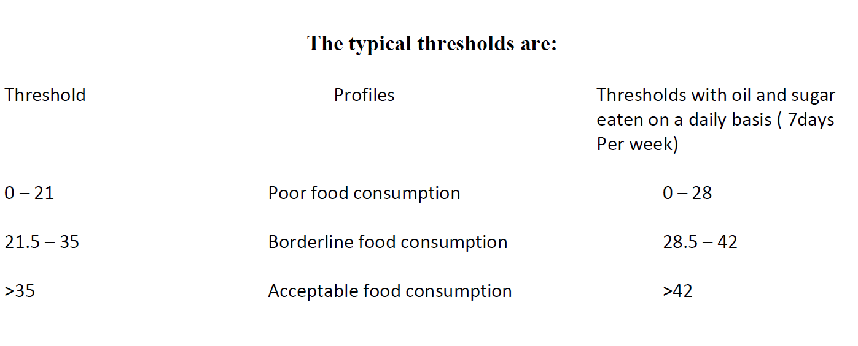
Materials and Methodology
Table showing the thresholds for food consumption score (Adopted from WFP, 2008)
we considered families on borderline food cosumption scores as food insecure families in this research.
We discovered 80.01% of our population are food secure, 17.58% have borderline food consumption, 2.41% are food insecure.
Consequently 80.01% have food security and 19.99% are food insecure.

Slide 12
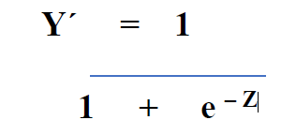
Materials and Methodology
Faculty of Agriculture
Empirical strategy
We chose a binary choice model (Logistic regression) since our dependent variable i.e food security is binary.
𝑃𝑟𝑜𝑏(𝑌 = 1|𝒙) = 𝐹(𝒙, 𝛽)
𝑃𝑟𝑜𝑏(𝑌 = 0|𝒙) = 1 − 𝐹(𝒙, 𝛽)
Our sample's Y' is the output of a logistic regression analysis.
Z = b + w1x1 + w2x2 + …+ wnxn
Z = log ( y/1-y )
Our logistic model for this thesis will be defined as follows;
Log(food security) = b + w1(social protection) + w2(occupation) + w3x3 +…. + wn xn
With social protection coded as 1 = received and 0 = did not receive.
All other independent variables were as well coded 1 = yes and 0 = no except continuous variables like Households and Non-food expenditure (MWK).
Robustness was finally carried out by using food consumption score as our dependent variable to make sure our analysis is as robust as possible.

Slide 13
Results and Discussion
Faculty of Agriculture
Descriptive statistics
Variables full sample
(n = 11,427)
Dependent Variable
Food Security (1 = yes, 0 = No) 0.800
(0.40)
Control Variables
Social protection (1=yes, 0 = No) 0.040
(0.198)
Occupation (1 =Farmers, 0 = others) 0.852
(0.356)
Household size (Persons) 4
Residence (1 = Urban, 0 = rural) 0.183
(0.387)
Credit ( 1 = yes, 0 = No) 0.308
(0.462)
Death (1 =yes, 0 = No) 0.062
(0.240)

Slide 14
Results and Discussion
Faculty of Agriculture
Business ownership (1 = yes, 0 = No) 0.080
(0.271)
Gender (1 = Male, 0 = Female) 0.518
(0.500)
Education (1 =yes, 0 = No) 0.876
(0.330)
Chronic illness (1=yes, 0=No) 0.110
(0.309)
Other incomes recieved (1=yes, 0=No) 0.054
(0.226)
Shocks (1 = yes, 0 = No) 0.174
(0.379)
Non-food expenditure(MWK) 649.60
Note: n = number of households, figures in parenthesis show the standard deviation

Slide 15
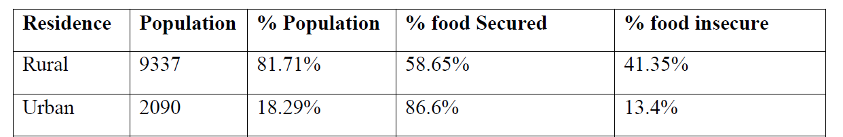
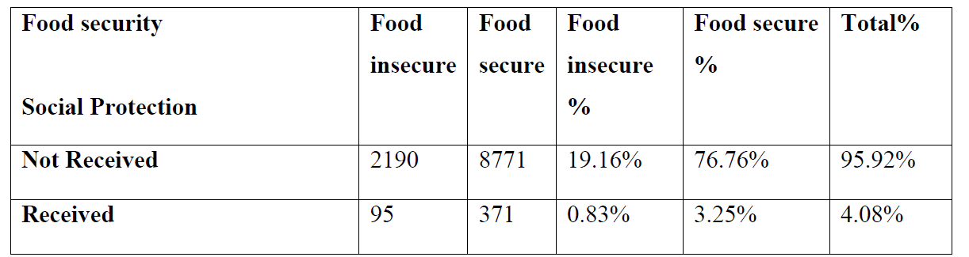
Results and Discussion
Faculty of Agriculture
Own depiction of table showing food status and residence
Own depiction of table showing food status by social protection

Slide 16
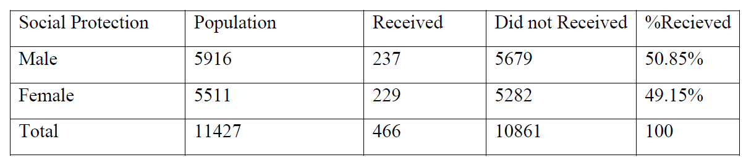
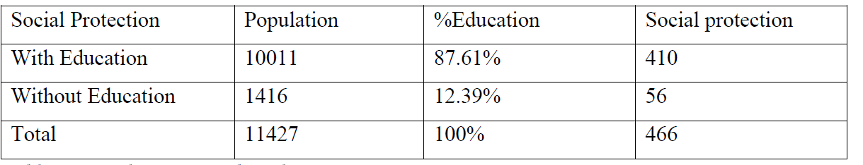
Results and Discussion
Faculty of Agriculture
Own description of table showing social protection by gender
Own depiction of table showing social protection by education

Slide 17
Results and Discussion
Faculty of Agriculture
Logistic Regression results
1 2 3
Dependent Variable
Food security
Independent Variable
Social protection (1=yes, 0 = no) 0.06 0.06 0.07
(0.789) (0.789) (0.789)
Reside (1=Urban, Rural=0) 1.52*** 1.52*** 1.51***
(0.000) (0.000) (0.000)
Business ownership (1=yes, 0=no) 0.46*** 0.46*** 0.45***
(0.000) (0.000) (0.000)
Education (1=yes, 0=no) 0.21* 0.21* 0.21*
(0.098) (0.098) (0.098)
Household (1=yes, 0=no) 0.05 0.05 0.05
(0.204) (0.204) (0.204)
Death (1=yes, 0=no) -0.11 -0.11
(0.195) (0.195)

Slide 18
Results and Discussion
Faculty of Agriculture
1 2 3
Chronic Illness (1=yes, 0=no) -0.03 -0.03
(0.965) (0.965)
Gender (1=male, 0=female) -0.03 -0.03
(0.770) (0.770)
Shocks (1=yes, 0=no) 0.06 0.05
(0.488) (0.488)
Non-food Expenditure (MWK) -0.02
(0.241)
Other incomes (1=yes, 0=no) -0.22**
(0.044)
Credit (1=yes, 0=no) -0.03
(0.534)
Occupation (1=farmer, 0=others) -0.11**
(0.048)
Constant 0.14 1.00 1.31
R2 0.80 0.80 0.80
Observations 9,141 9,141 9,141
Standard errors in parenthesis ***p < 0.01, **p < 0.05, *p < 0.1

Slide 19
Results and Discussion
Faculty of Agriculture
Our data was divided into train and test models in ratio 80 : 20.
The purpose of the test is to eliminate bias and also test how the model will perform on a similar data.
We obtained an R2 of 80% with our test model. This means our model is correct in 80% of the cases.
Since our social protection variable is not significant, we proceed by dividing our results into residence (rural and urban).
Then we run a seperate regression on the results to see how our social protection variable will perform.

Slide 20
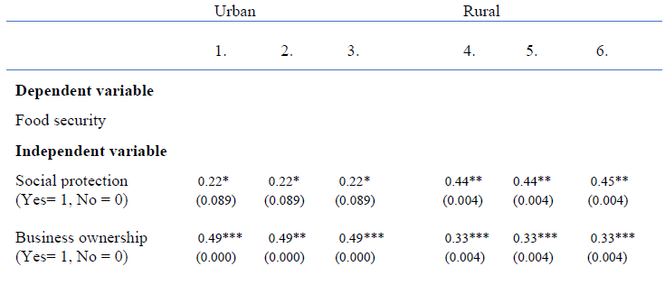
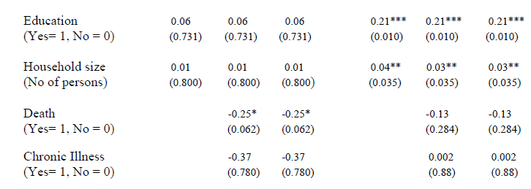
Results and Discussion
Faculty of Agriculture
Logistic regression showing results by residence

Slide 21
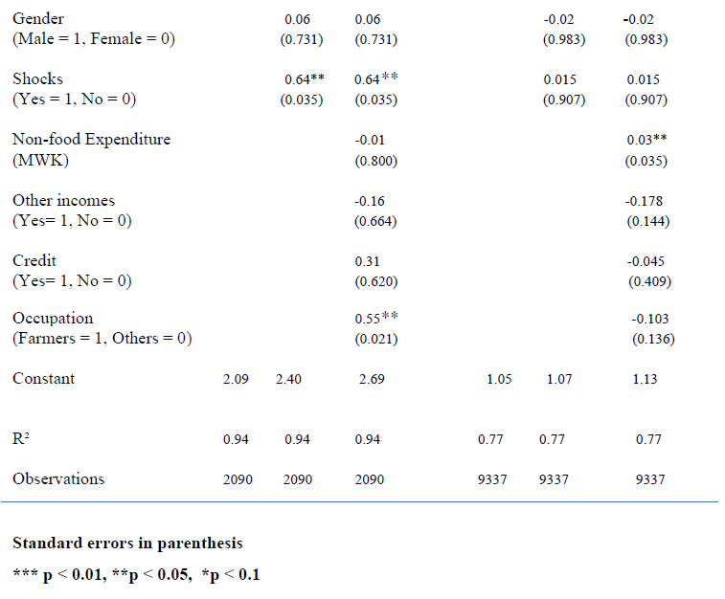
Results and Discussion
Faculty of Agriculture

Slide 22
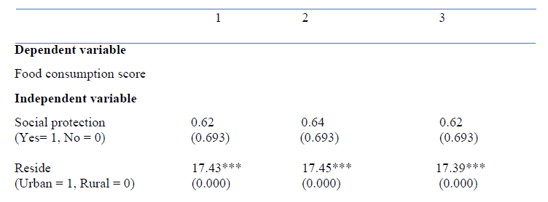
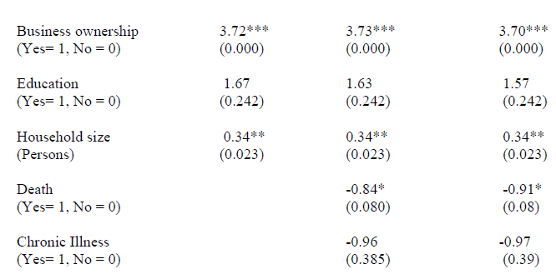
Results and Discussion
Faculty of Agriculture
Robustness with OLS with food consumption score as the dependent variable

Slide 23
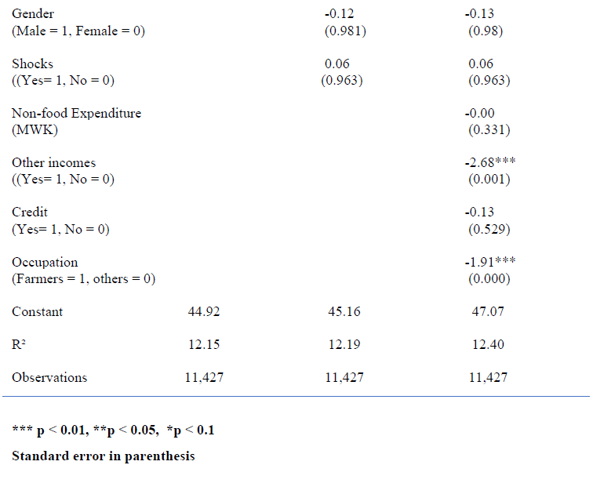
Results and Discussion
Faculty of Agriculture

Slide 24
Conclusion
Faculty of Agriculture
Social protection importance can be a factor of residence as it is more important in rural areas than urban areas.
It most cases short-term projects or programs like the PWPs only offer temporary effects and thus may not really have a significant effect on food security.
Existing research also upholds the findings in this study.
Limitation and further research
The data used for this research do not ascertain the particular social nets recieved by the individual families.
Further improvement should be made on the kind of data collected by world bank.
The use of a week recall period to determine food consumption score may be insufficient.

Slide 25
Thanks for listening
Faculty of Agriculture

Slide 26
References
Faculty of Agriculture
Cirillo, C., & Tebaldi, R. (2016). SOCIAL PROTECTION IN AFRICA: INVENTORY OF NON-CONTRIBUTORY PROGRAMMES. www.intranet.unicef.org. Retrieved: March 23, 2023.
Food and Agriculture Organization (2008) An Introduction to the Basic Concepts of Food Security. Published at: http://www.foodsec.org/docs/concepts_guide.pdf. Retrieved on August 23, 2022.
FAO (2020) The state of Food Security and Nutrition in the World 2021.Published at: https://www.fao.org/state-of-food-security-nutrition/2021/en/#:~:text=In%202020%2C%20between%20720%20and%20811%20million%20people%20faced%20hunger&text=After%20remaining%20virtually%20unchanged%20from,8.4%20percent%20a%20year%20earlier. Retrieved on March 21, 2023.
WFP (2008) Interagency workshop report
World Bank (2018) ' The State of Social Safety Nets 2018'. Available at: https://openknowledge.worldbank.org/handle/10986/29115 (Accessed: 13, Nov 2022).
World Bank, (2020). Food security. Available at https://www.worldbank.org/en/topic/food-security. (Accessed: 13, Nov 2022.
World Bank (2022) 'The World Bank Group supports Malawi's efforts to reduce poverty and promote economic growth by working with the government, development partners, and civil society. Available at https://www.worldbank.org/en/country/malawi/overview. (Accessed: 14, Nov 2022.

